Slide 1


AMAZON’S ELECTRONIC PRODUCT ANALYSIS
ANDREW NG (2021)

Slide 2
Dear readers,
Kindly refer to my comment section for further explanation on my analysis on each slide.
Thanks for reading & hope you enjoy this analysis created by me.
Best regards,
Andrew Ng

Slide 3
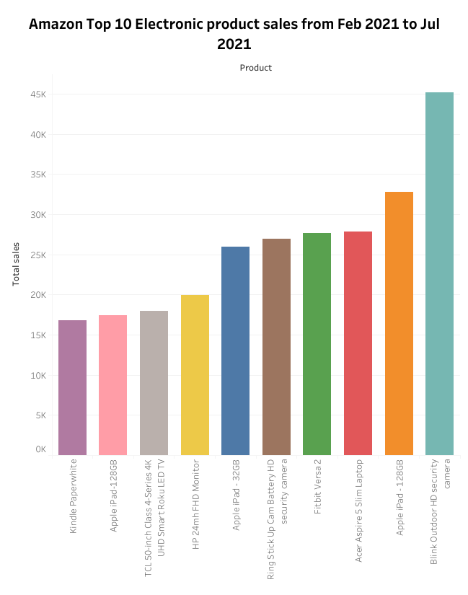

Data Overview
Top 10 electronic products sold via Amazon
Search queries are limited to Amazon US only
Data from Feb 2021 to Jul 2021

Slide 4
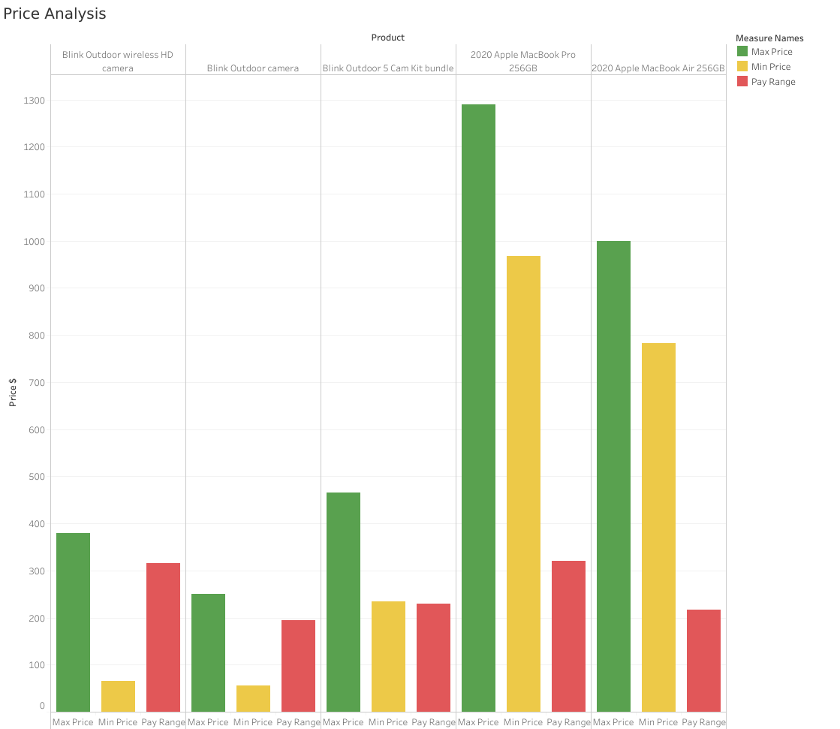
Pay range =Max Price – Min price

Slide 5


Category Spend
=
FREQUENCY
X
AVERAGE PRICE

Slide 6

THANKS FOR READING

